Slide 1
Personal Health Budgets Overview Marie Reynolds PHB Senior Manager – South Region NHS England

Slide 2
Background & Context

Slide 3
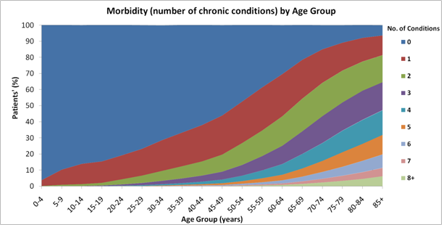
The Challenges facing the NHS
1. Increasing number of people living with more than one LTC – increasing demand on services.
2. Safety – Francis, Berwick & Winterbourne.
3. Facing a decade without any increase in spending, unprecedented in NHS history, set against rising demand (4% pressure p/a).
Notes:
Increasing demand on services
Recent reports into the safety and quality of care highlight the need for a radical change in the way support and services are commissioned particularly for those with behaviour that challenges.
Financial pressures force us to deliver those changes without significant increases in investment.

Slide 4
Personal health budgets are part of mainstream NHS
Continuing healthcare: ‘Right to have’ in NHS continuing healthcare and children’s continuing care since October 2014.
Children and Families Act 2014: Children who have special educational needs should have a single assessment, an Educational, Health and Care Plan and the option of a personal budget.
The NHS Mandate 2015-16: From April 2015, people with long term conditions who could benefit should have the option of a PHB.
The NHS Mandate 2016-17: 50-100,000 people to have a PHB or integrated personal budget by 2020…produce a plan with specific milestones for improving patient choice by 2020 particularly in …personal health budgets.

Slide 5
Key features of PHBs

Slide 6
Five essential parts of a personal health budget
The person with the personal health budget (or their representative) will:
Be able to choose the health and wellbeing outcomes they want to achieve, in agreement with a health care professional.
Know how much money they have for their health care and support.
Be enabled to create their own care plan, with support if they want it.
Be able to choose how their budget is held and managed, including the right to ask for a direct payment.
Be able to spend the money in ways and at times that make sense to them, as agreed in their plan.

Slide 8
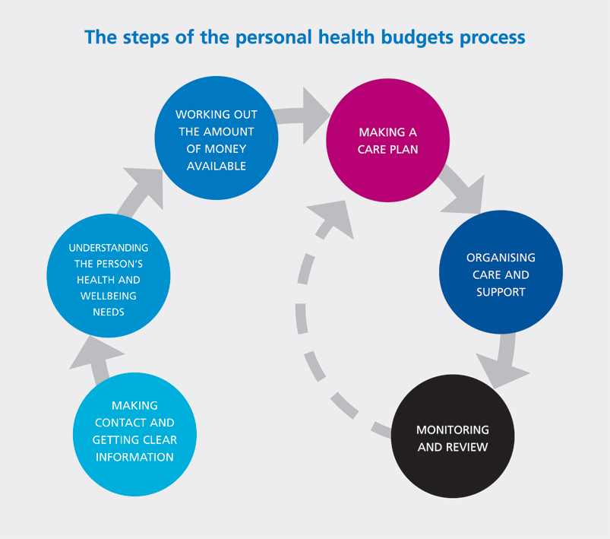

Slide 9
What is excluded?
GP services (GP contract).
Acute unplanned care (including A&E).
Surgical procedures.
Medication.
NHS charges e.g. prescription charges.
Vaccination/immunisation.
Screening.
Gambling, debt repayment, alcohol, tobacco.

Slide 10
What can they be spent on?
Anything agreed in a care plan which will meet health and wellbeing outcomes, for example
Equipment.
Personal care.
Physiotherapy.
Complementary therapies.
Supportive technology (e.g. computers, iPads, Kindles).
Services should be appropriate for the state to provide.

Slide 11
What needs to be different?
One person at a time: supporting people to live in their own home or family home – at same cost or less than conventional services
Outcome-based: focus on what matters to the person and their family, build on people’s assets and interests
Whole-life, whole family approach: housing, education, employment, leisure and interests, not just health and care needs
Joined-up – collaboration across organisations, transition from children to adult services, and between social care and health
Tailor-made solutions: Direct payments, individual service funds/third party budgets, equipment, support from hand-picked, well-trained people
Risk enablement: thinking differently and being creative
Developing peer support and VCS: peer networks, support planning, advice and advocacy
Notes:
From recent key reports, guidance documents and our discussions with service users we can define what changes need to be made.
Clear that the approach needs to be person-centred.
How do we build personalisation into overall service delivery to achieve those changes?

Slide 12
Learning so far

Slide 13
Independent evaluation cost effectiveness (even saving money for some)
The PHB evaluation looked at direct and indirect costs. It showed that:
Direct costs were marginally higher for the PHB group
Indirect costs were significantly lower for the PHB group (e.g. through fewer GP visits and reductions in unplanned admissions)
Overall, costs were lower for the PHB group and some high cost packages (e.g. in CHC) saw significant savings.
Notes:
The evaluation offers more detail on where savings/efficiencies in the system can be found.

Slide 14
Learning so far: what can help
Ensuring a strong voice for service users and families throughout
Using people’s stories and promoting good practice
Targeting family carer and self-advocacy groups to raise awareness
Peer support and independent brokerage
Holistic and personalised support planning
Commitment to joint working
It shouldn’t matter where the money comes from!

Slide 15
Learning so far: pitfalls
Can be hard to make the right links locally
Senior people need to be on board
Caution and risk aversion
“Ping pong” between children’s services, adult services and NHS/social care
“What’s new/we are already person-centred”
It takes a lot of work and time to make change happen even for a few people
Focus only on individual at expense of strategic change

Slide 16
Challenges
Patient selection / agreeing the scope.
Developing supportive infrastructure.
Capacity.
Ensuring equity.
Managing expectations.
Maintaining values, principles and integrity of the NHS.
Co-production.
Disaggregation of block contracts.
Cost pressure of funding previous unassessed / unmet need.
Developing the market.
Culture change.
Risk management.
Workforce development.
Information governance.
Measuring success.
Notes:
Implementation of PHBs represents a major change for the NHS in terms of operational processes, training and culture change
It requires collaboration within and across organisations therefore it can be very challenging.
Anticipating those potential challenges will help to define ways to address them.

Slide 17
The potential - if done well
Big benefits when targeted at people who make high use of the NHS – better outcomes and quality of life plus large reductions in use of hospital after getting a personal health budget – between £1,300 and £4,000 per year
People with long term conditions and those using mental health services benefit the most.
Notes:
The national pilot evaluation highlights the potential advantages when PHBs are delivered well.

